Slide 1
Meeting with Oksana
24/04

Slide 2
Tasks From Last Meeting
Change flight time to time to hit the goal

Slide 3
Completed Tasks

Slide 4
Dataset Creation
Ball starts and ends in the field
Ball starts outside from the goal area
Vmin = 1m/s (this may be too small for rolls)
Vmax = 10m/s
Ball starts in the field of view
Minimum time flight = 0.3 s (to avoid small throws)
Goal area
Cropped trajectory when out of FOV

Slide 5
Dataset Creation
Goes In 70%
Almost goes in 15%
Goes out 15%

Slide 6

PISNN
I restructured the networks to accept different loss functions
New model: predicts x, y and z through regression
Then computes a_x, a_y and a_z through
Finally computes loss as L_phys + L_data, where
L_phys = a_x^2 + a_y^2 + (a_z + g) ^ 2

Slide 7
Ongoing and Proposed Future Tasks

Slide 8
Ongoing Tasks
Creation of the dataset
Trajectory generation wasn’t working in IsaacSim last time I tried.
Event Simulation
I am working on event processing
This is necessary for making tuning the event generation parameters.
Problem with video duration: the video from the simulator gets artificially cropped

Slide 9

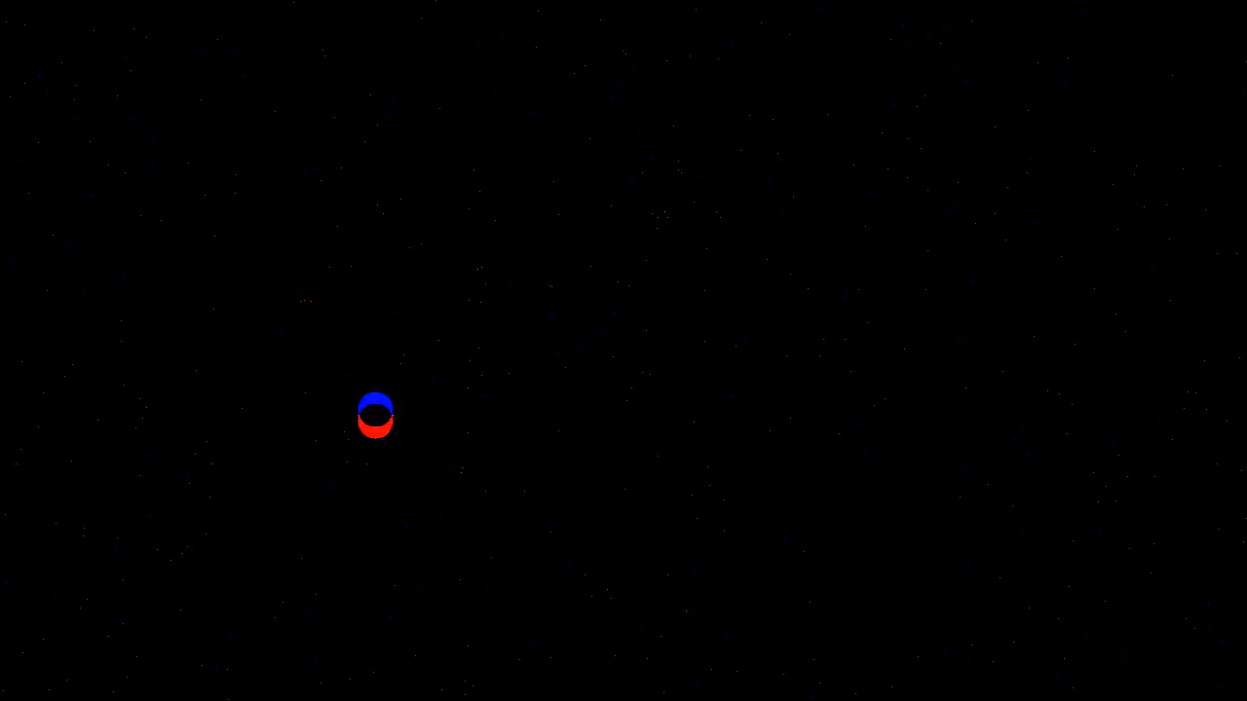

Slide 10
Proposed Future Tasks
I restructured the networks to accept different loss functions
New model: predicts x, y and d through regression
Transformation to world coordinates X, Y, Z wrt the goalie
Then computes a_x, a_y and a_z through
Finally computes loss as L_phys + L_data, where
L_phys_g = a_x^2 + a_y^2 + (a_z + g) ^ 2
L_phys_D = (Dpred-D)^2

Slide 11
Ldata
Ldata-deltat
Lphys+Ldata
Explore how to get D from the model. Regression? Class? F(D)?

